Slide 1
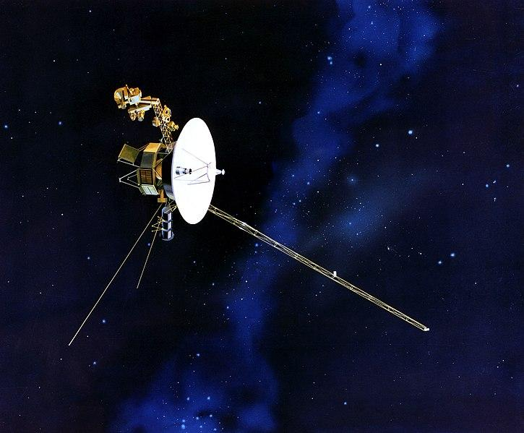

Mission Overview and Trajectory Analysis of the Voyager 2 Mission
Tyler Brooks (0759179)
John Erdman (0942922)
Ryder Hoffman (0947903)
Clarkson University
Department of Mechanical and Aerospace Engineering
April 25th, 2023

Slide 2
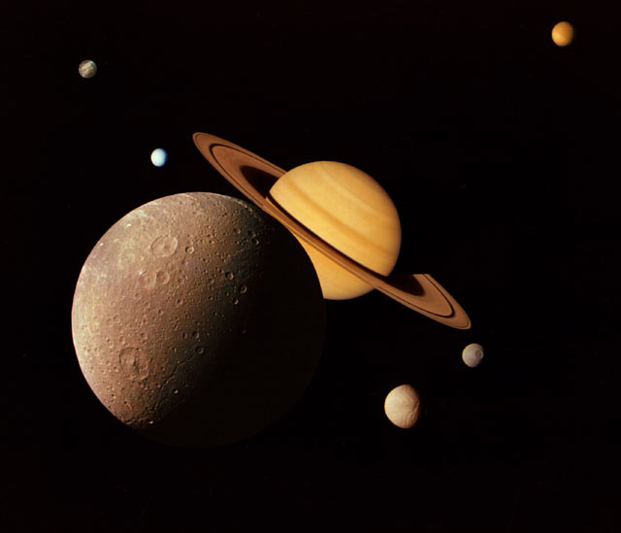
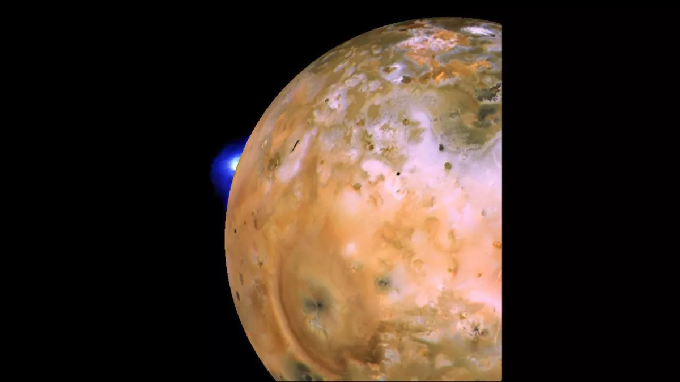
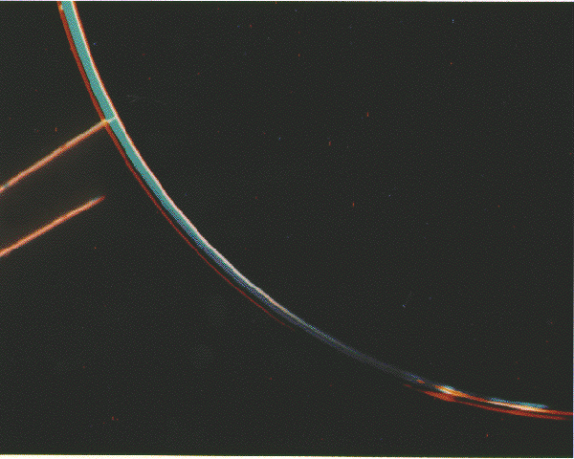
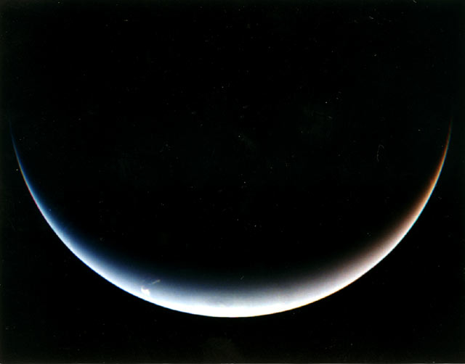
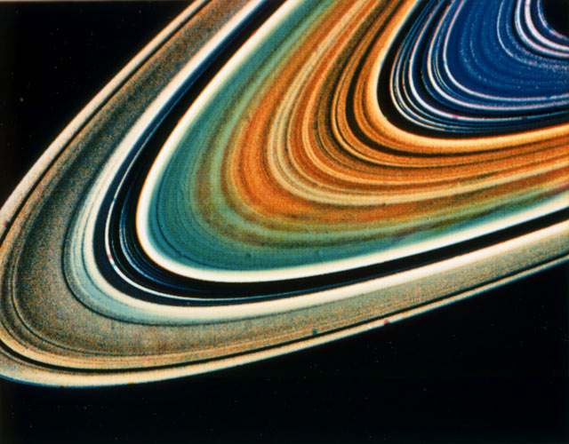
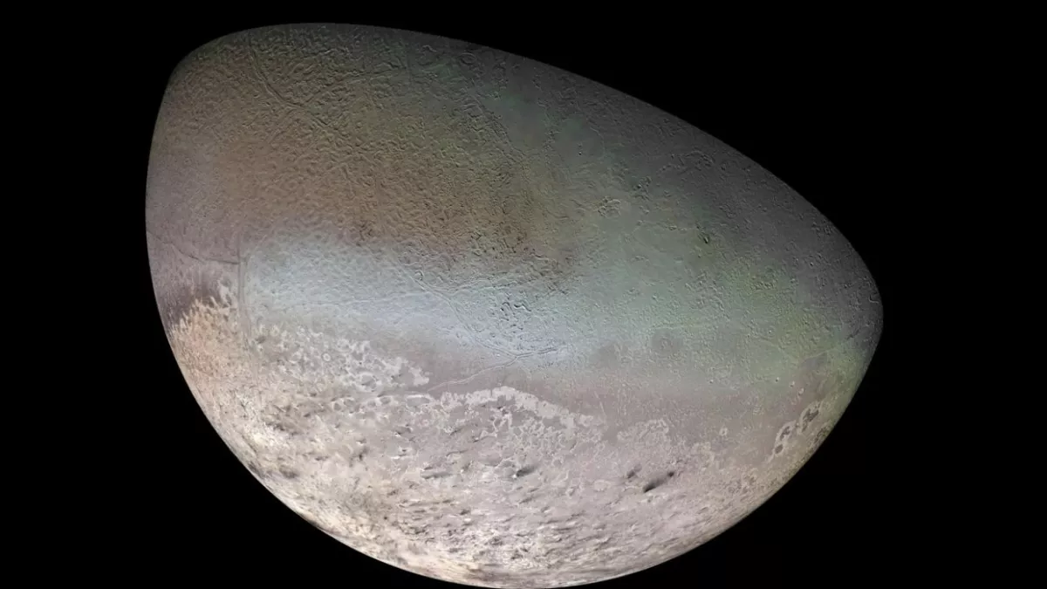
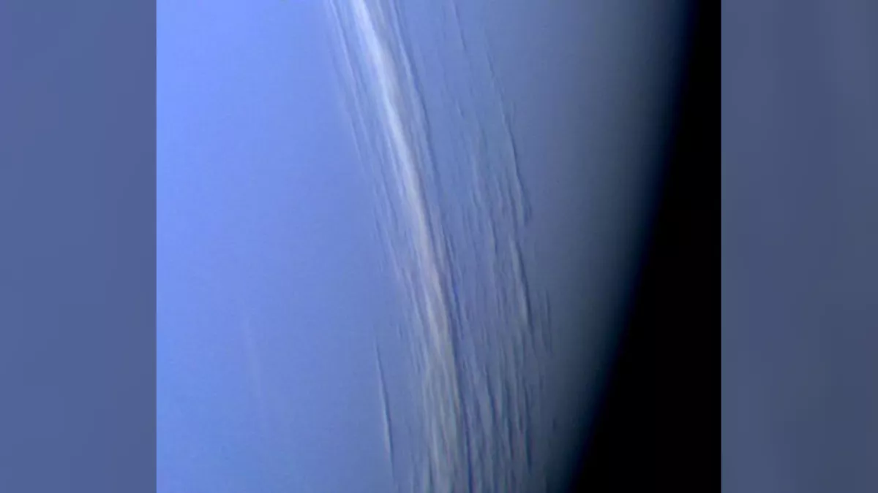
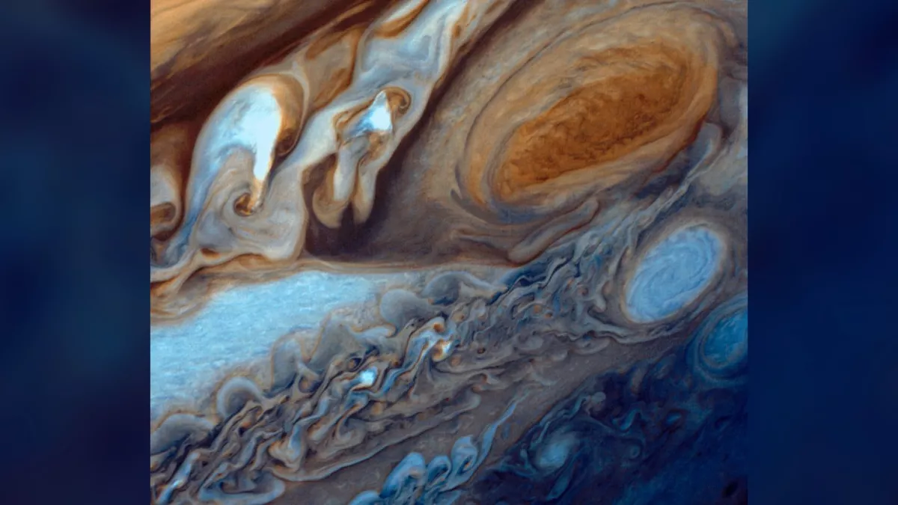
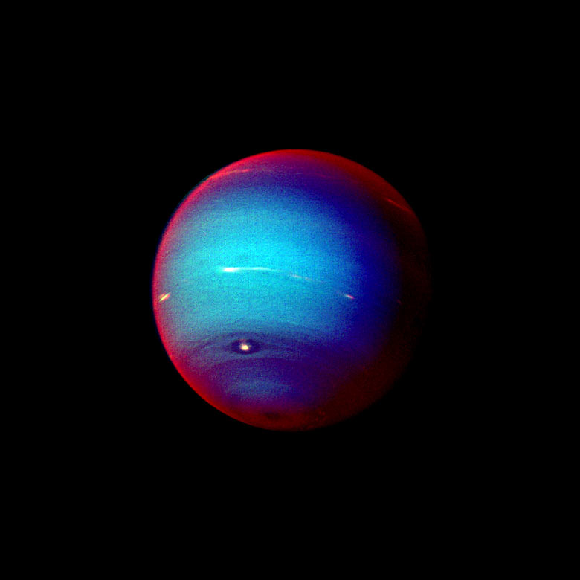
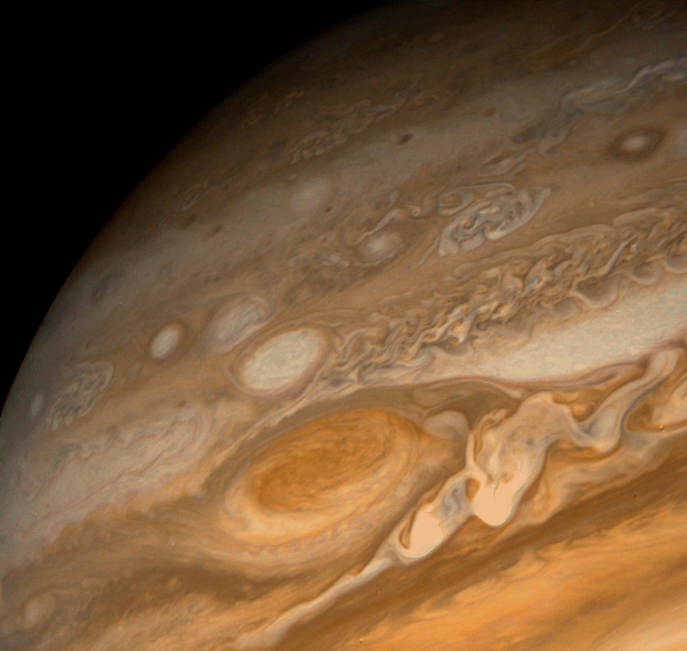
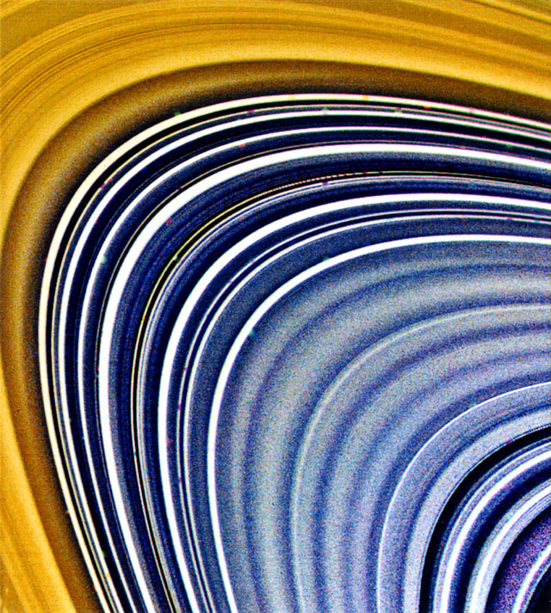
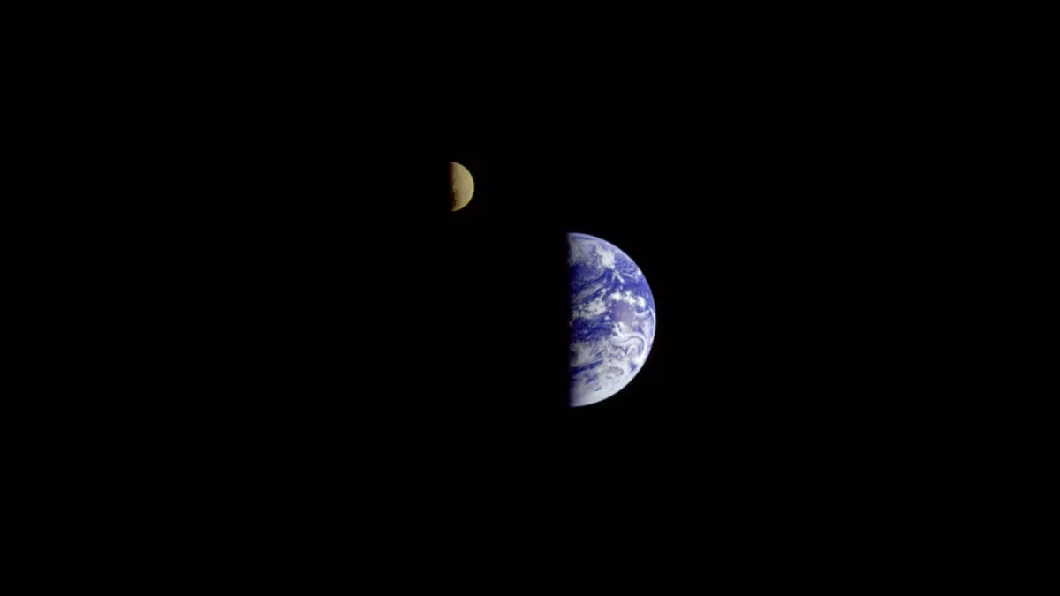
Place pics here

Slide 3
Executive Summary

Slide 4
Executive Summary
Mission Overview
Attitude Orbital Control System
On-Board Instrumentation
Orbital Trajectory
Model-Trajectory Comparison
NASA, “Galleries of Images Voyager Took” NASA Image Gallery,Various Dates.Available: https://voyager.jpl.nasa.gov/galleries/images-voyager-took/

Slide 5
Mission Overview
NASA, “Galleries of Images Voyager Took” NASA Image Gallery,Various Dates.Available: https://voyager.jpl.nasa.gov/galleries/images-voyager-took/

Slide 6
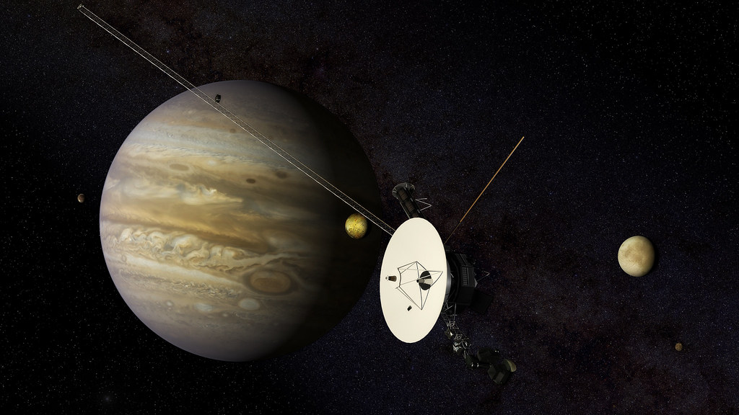
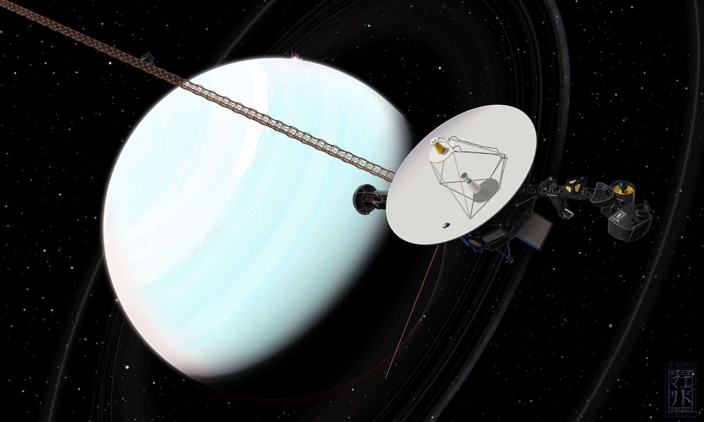
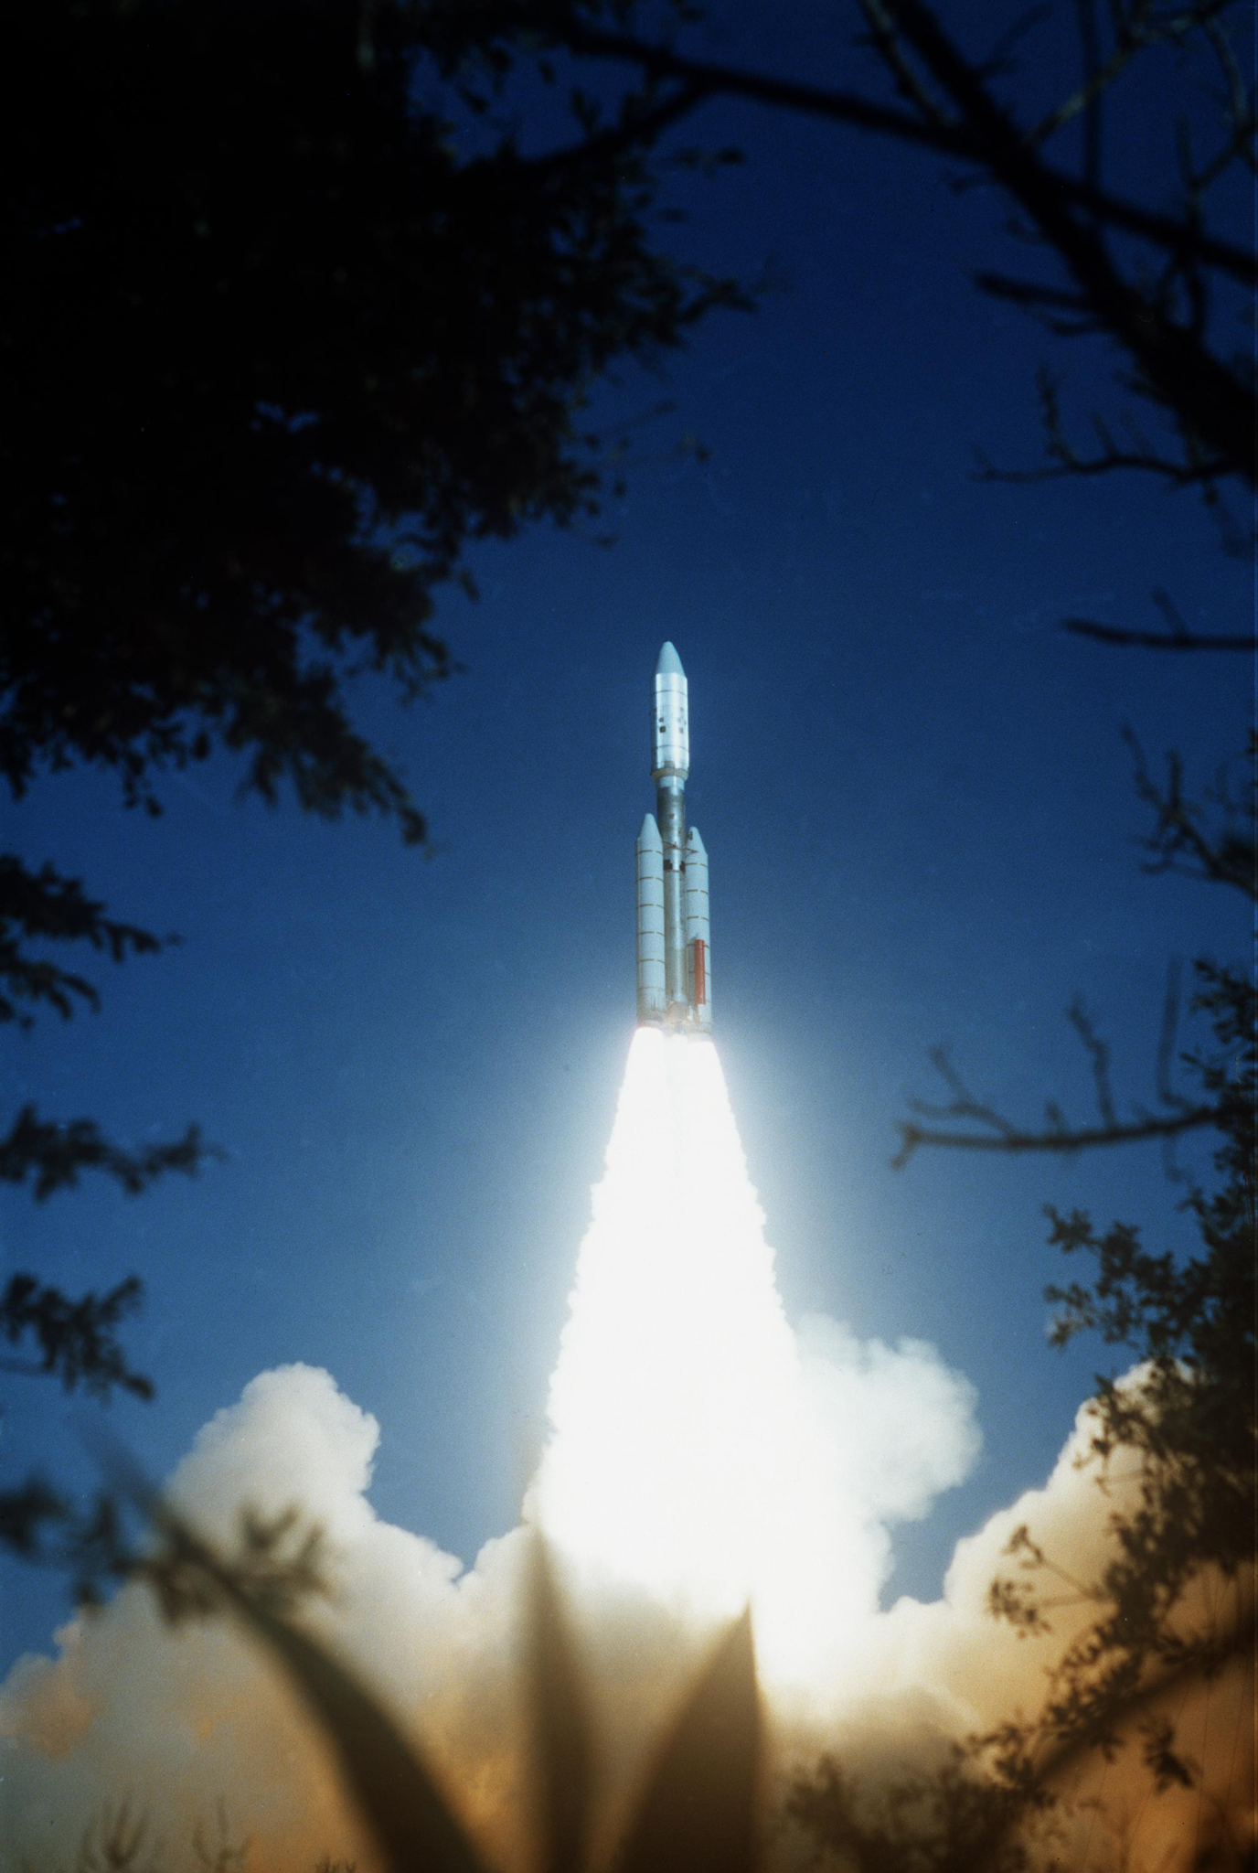
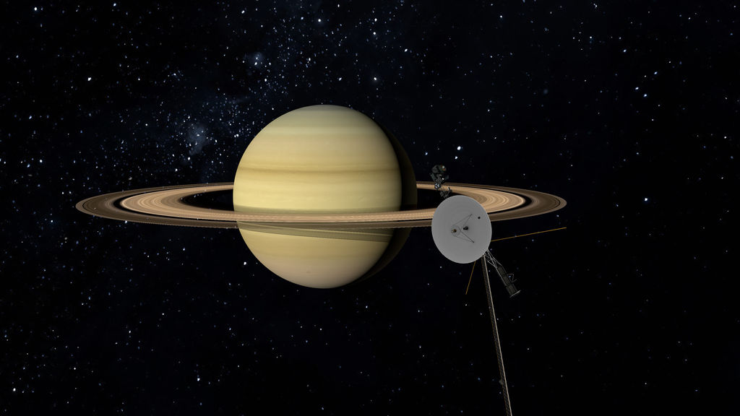
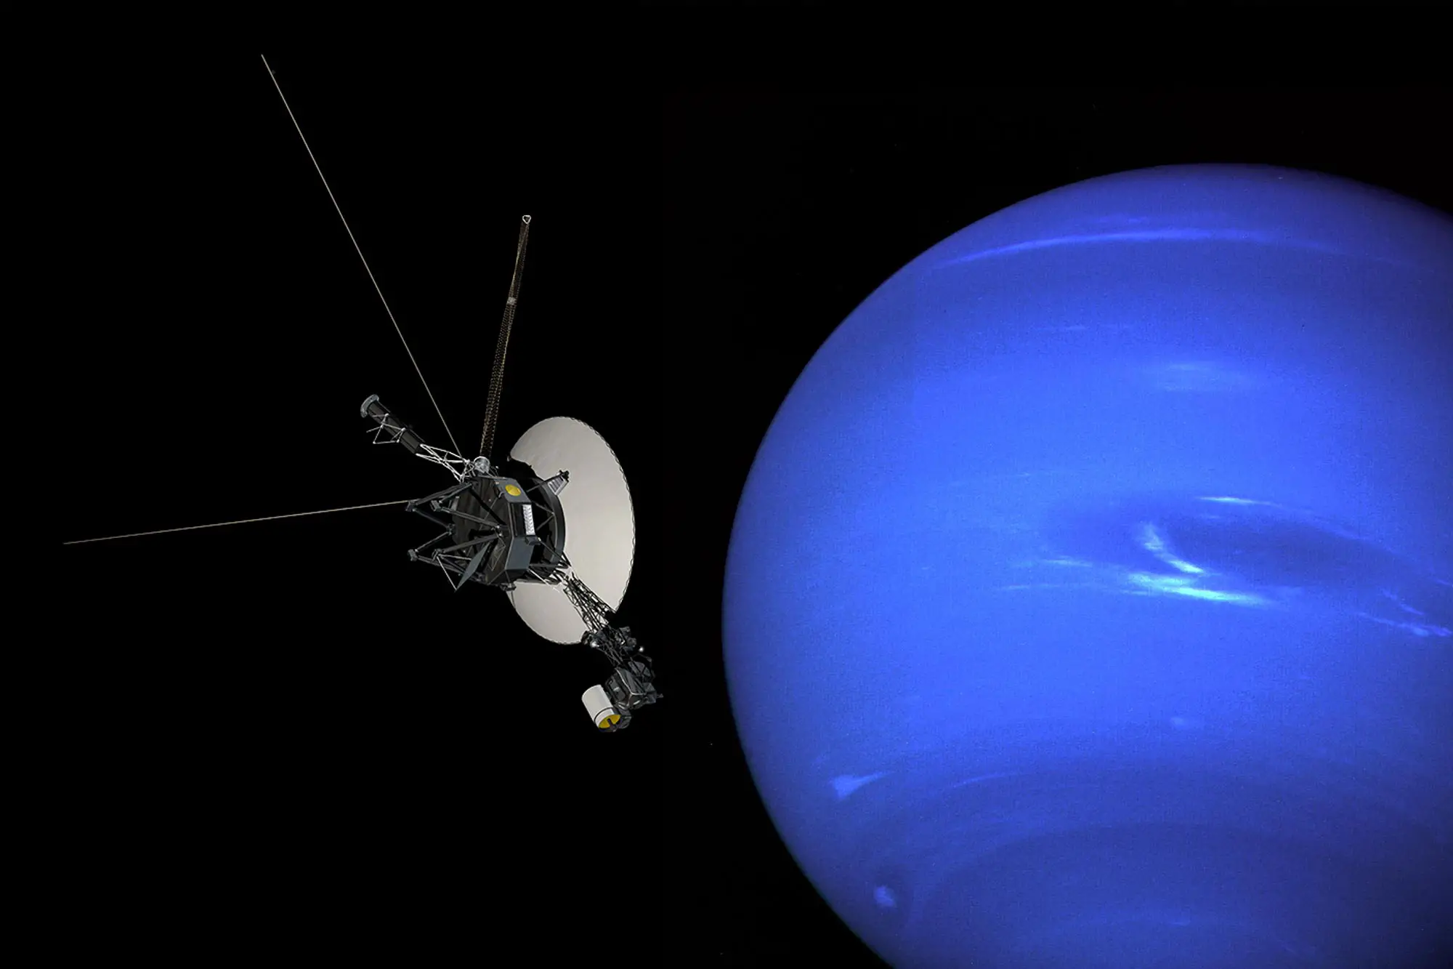
Mission Overview: Flight Timeline
Saturn
August 26th 1981 01:21:00
Neptune
August 25th 1989 03:56:00
Launch
August 20th 1977 14:29:44
Jupiter
July 9th 1979 22:29:00
Uranus
January 24th 1986 17:59:00
N. A. S. A. J. P. Laboratory, “JPL and the space age: The footsteps of voyager (NASA documentary),” SciTechDaily, 08-Apr-2023. [Online]. Available: https://scitechdaily.com/jpl-and-the-space-age-the-footsteps-of-voyager-nasa-documentary/.

Slide 7
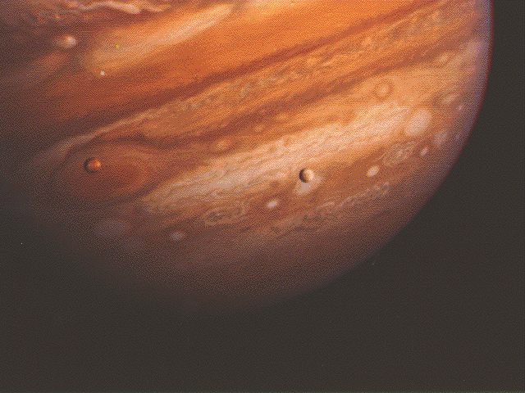
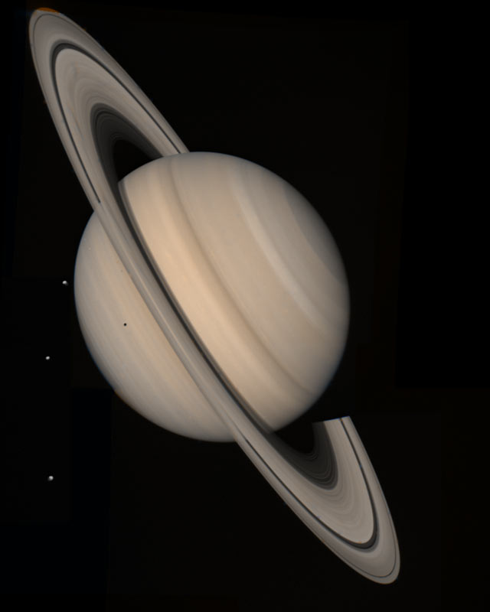
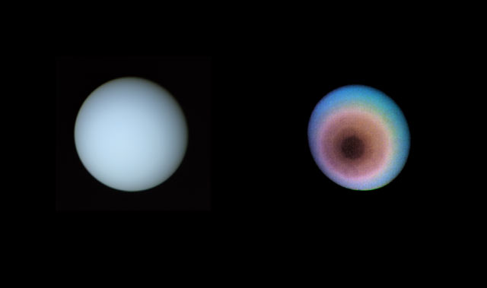
Mission Overview: Purpose
Observe Jupiter’s magnetic field, moons, volcanos, and its red spot
Study Saturn’s rings, atmosphere, discovered three new moons, and magnetic field
Measured Uranus' magnetic field, atmosphere, and discovered 10 new moons
Study Neptune including the planet's Great Dark Spot
Currently exploring the outer regions of our solar system and interstellar space, providing valuable information about the heliosphere and cosmic environment.
“Voyager - Images voyager took of Neptune,” NASA. [Online]. Available: https://voyager.jpl.nasa.gov/galleries/images-voyager-took/neptune/.
Notes:
Rings composition

Slide 8
Attitude Orbital Control Systems
NASA, “Galleries of Images Voyager Took” NASA Image Gallery,Various Dates.Available: https://voyager.jpl.nasa.gov/galleries/images-voyager-took/

Slide 9
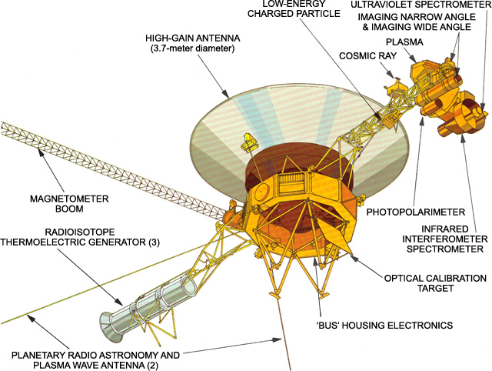
Attitude and Orbital Control System (AOCS)
Celestial Attitude Control:
Sun Sensors to control Pitch and Yaw
Star Tracker to control Roll
Gyroscopic Attitude Control:
Set of gyros that sense angular position
Hydrazine Thrusters:
4 For Pitch Corrections
4 For Yaw Corrections
4 for Roll
4 For Overall Trajectory Corrections
B. Koerner, “What Voyager 1 uses for fuel.,” Slate Magazine, 06-Nov-2003.Available: https://slate.com/news-and-politics/2003/11/what-voyager-1-uses-for-fuel.html.

Slide 10
AOCS: On-board Instrumentation
Radioisotope Thermoelectric Generator:
Provides power using decaying Plutonium-238
Magnetometer:
Collects magnetic field data.
High Gain Antenna:
Sends info back to Earth
Visible Light Camera:
Takes images
8 different filters
Infrared Interferometer Spectrometer:
Measures temperatures
Ultraviolet Spectrometer:
Measures UV light
B. Koerner, “What Voyager 1 uses for fuel.,” Slate Magazine, 06-Nov-2003.Available: https://slate.com/news-and-politics/2003/11/what-voyager-1-uses-for-fuel.html.

Slide 11
Orbital Trajectory

Slide 12
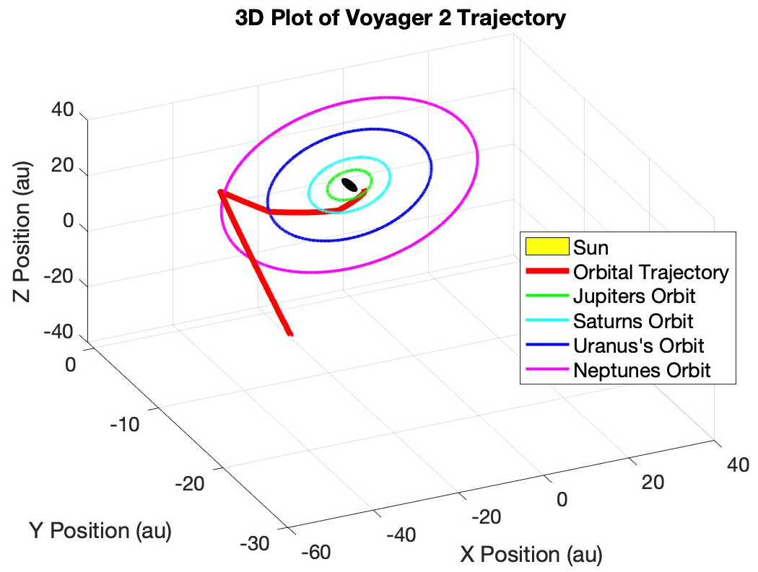
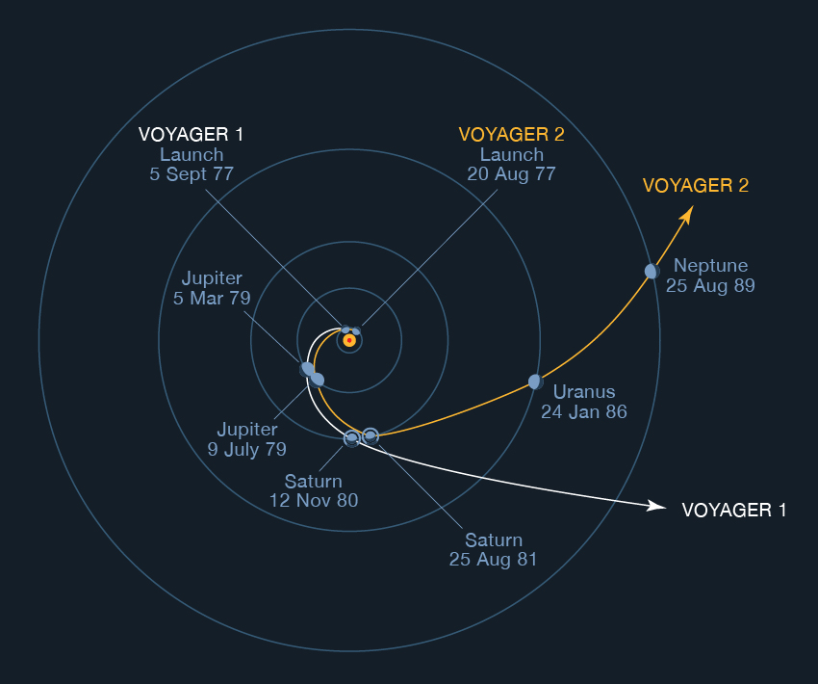
Orbital Trajectory
Voyager 2 Orbital Maneuvers:
Injection Maneuver Into Jupiter’s SOI
Hyperbolic Flyby:
Jupiter
Saturn
Uranus
Neptune
Using Neptune As A Slingshot Out Of The Sun’s Orbital Plane
Ota Lutz, “Then There Were Two: Voyager 2 Reaches Interstellar Space” Teachable Moments,12/18/18.Available: https://www.jpl.nasa.gov/edu/news/2018/12/18/then-there-were-two-voyager-2-reaches-interstellar-space/
NASA, “Galleries of Images Voyager Took” NASA Image Gallery,Various Dates.Available: https://voyager.jpl.nasa.gov/galleries/images-voyager-took/

Slide 13
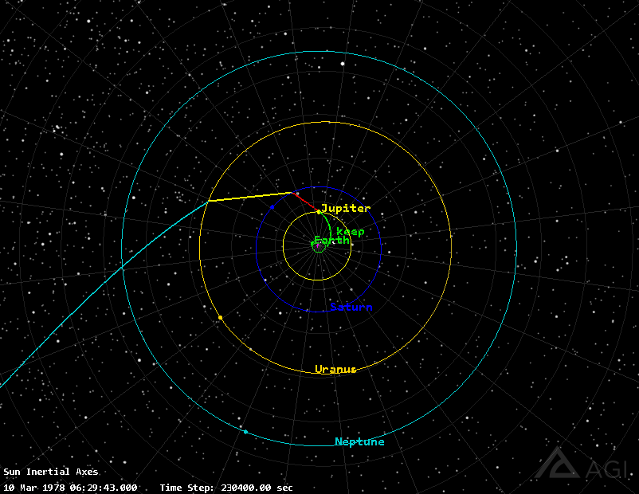
Orbital Trajectory: STK Model
Insert celestial body's
Process
Insert celestial body's
Create Satellite using astrogator
Insert maneuvers and properties in mission control sequence (MCS)
Run MCS
Extract data for planetary coordinates

Slide 14
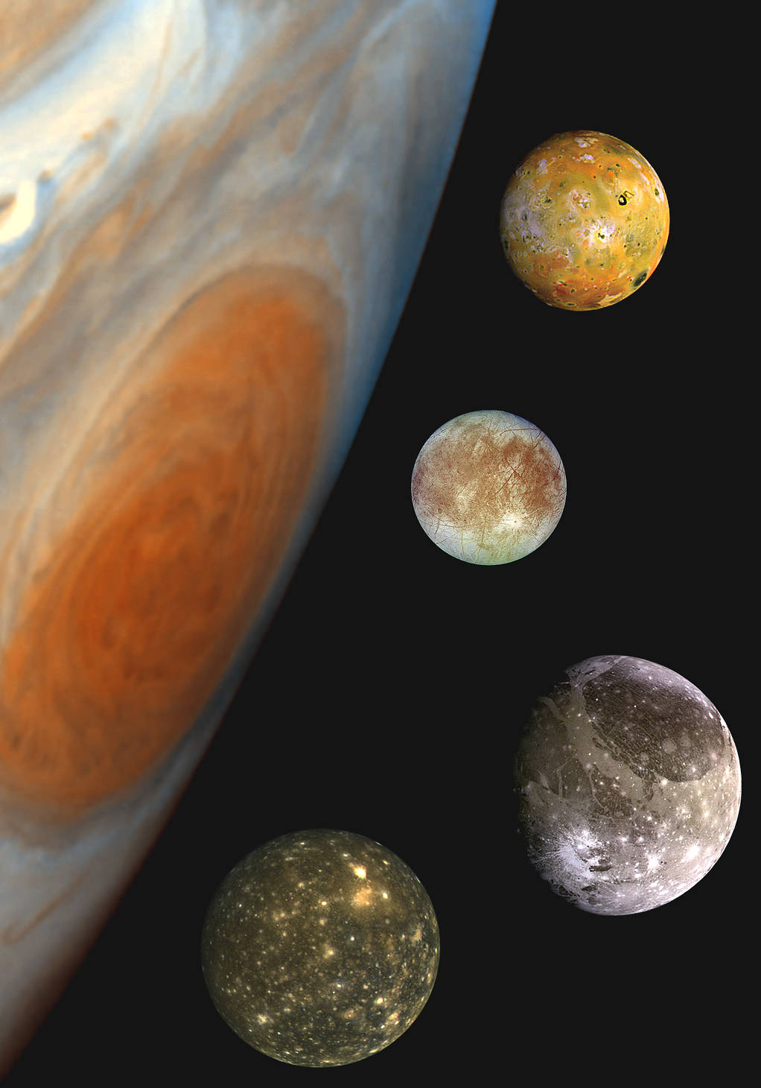
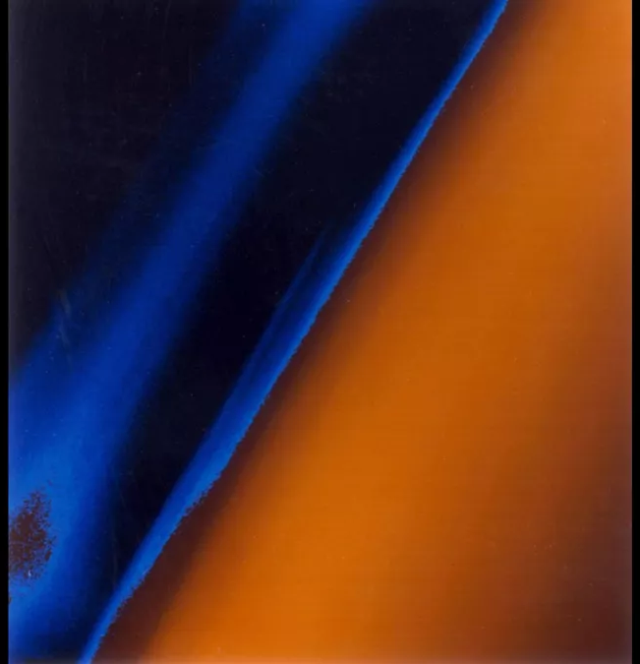
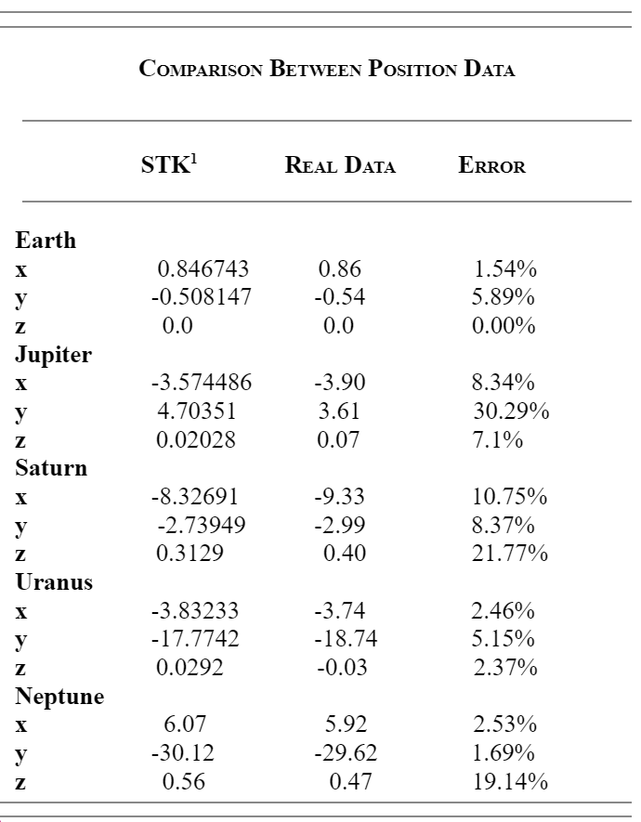
Orbital Trajectory: Model vs Real
Io, Europa, Ganymede and Callisto
Triton
Saturnian System: Titan
NASA, “Galleries of Images Voyager Took” NASA Image Gallery,Various Dates.Available: https://voyager.jpl.nasa.gov/galleries/images-voyager-took/
NASA, “Family Portrait of the Jovian System” NASA Image Gallery,Aug 7, 2017.Available:https://www.nasa.gov/multimedia/imagegallery/image_feature_592.html
Notes:
https://voyager.jpl.nasa.gov/mission/spacecraft/interactive.php

Slide 15
Conclusion
Average Errors During Each Flyby
Planet | Average Error
Earth | 2.48%
Jupiter | 15.24%
Saturn | 13.63%
Uranus | 3.33%
Neptune | 7.79%

Slide 16
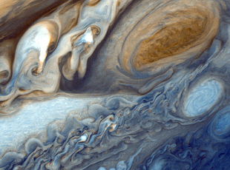
Q&A?

